Slide 1
Reporting and Analyzing Long-Term Assets
8
Chapter
UAA – ACCT 201 Principles of Financial Accounting Dr. Fred Barbee
Notes:
Chapter 8: Reporting and Analyzing Long-Term Assets
Dr. Fred Barbee

Slide 2
Day #1
IS FUN!
ACCOUNTING
ACCT 201 ACCT 201 ACCT 201
Notes:
Chapter 8: Reporting and Analyzing Long-Term Assets
Dr. Fred Barbee

Slide 3
Chapter 8 - Day 1 - Agenda
Topic | LO | Read | HW
Plant Assets | C1 | 332-333 | QS2, E3
Cost of Plant Assets | P1 | 333-335 | QS1, E1, E2
Depreciation | C2, 3 P2, A1 | 335-343 | E4,5,6,7, P1A
HW #6: P7-6A Due Today
Notes:
Chapter 8: Reporting and Analyzing Long-Term Assets
Dr. Fred Barbee

Slide 4

Plant Assets
Introduction to Long-Lived Assets
ACCT 201 ACCT 201 ACCT 201

Slide 5
Plant Assets
Tangible
Actively Used in Operations
ACCT 201 ACCT 201 ACCT 201
Expected to Benefit Future Periods
Property, Plant, and Equipment
Notes:
Chapter 8: Reporting and Analyzing Long-Term Assets
Dr. Fred Barbee

Slide 6
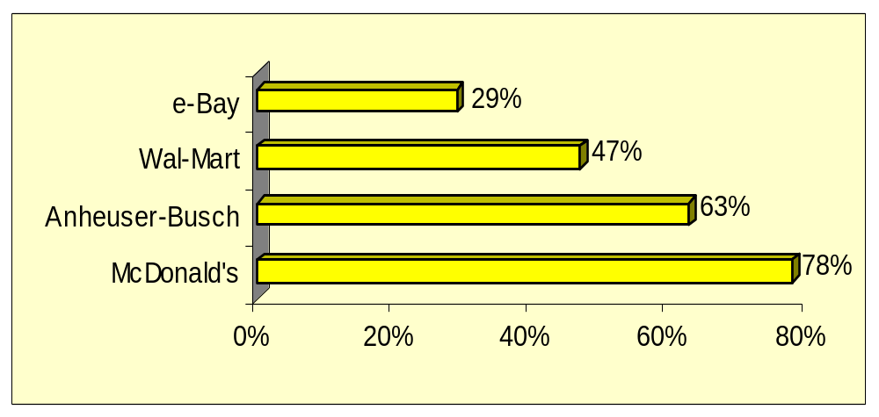
Plant Assets of Selected Companies
$44 million
$32,839 million
$7,965 million
$16,325 million
As a percent of total assets
Notes:
Chapter 8: Reporting and Analyzing Long-Term Assets
Dr. Fred Barbee

Slide 7
Issues Related to Plant Assets
Asset Service Potential
Acquisition
Use in business operations
Disposal
Cost
Principle
Matching
Principle
Gain or
Loss
Decline in future service benefits.
Book Value
Time
Accounting Issues
Measuring Cost
Allocating initial cost and subsequent maintenance/repairs.
Recording Disposals
Notes:
Chapter 8: Reporting and Analyzing Long-Term Assets
Dr. Fred Barbee

Slide 8
Cost of Plant Assets
Purchase
price
All expenditures needed to prepare the asset for its intended use
Acquisition
cost
Acquisition cost excludes financing charges and
cash discounts.
Notes:
Chapter 8: Reporting and Analyzing Long-Term Assets
Dr. Fred Barbee

Slide 9

Land
Purchase
price
Title insurance premiums
Delinquent
taxes
Real estate
commissions
Surveying
fees
Title search and transfer fees
Land is not depreciable
Notes:
Chapter 8: Reporting and Analyzing Long-Term Assets
Dr. Fred Barbee

Slide 10


Buildings and Equipment
Purchase
price
Installation
costs
Architectural
fees
Transportation
costs
Cost of
permits
Excavation and
construction costs
Notes:
Chapter 8: Reporting and Analyzing Long-Term Assets
Dr. Fred Barbee

Slide 11
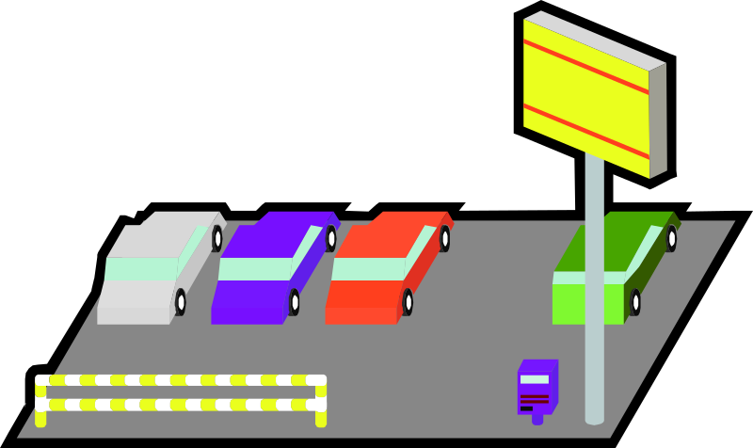
Land Improvements
Parking lots, driveways, fences, walks, etc.
Depreciate over useful life.
Notes:
Chapter 8: Reporting and Analyzing Long-Term Assets
Dr. Fred Barbee

Slide 12
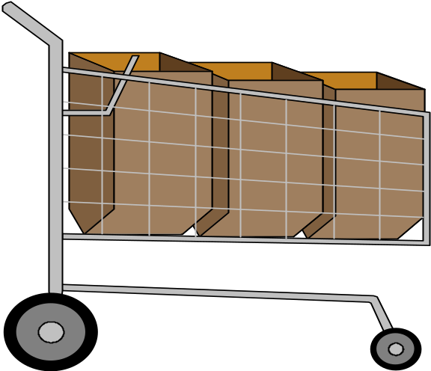
Basket “Lump-Sum” Purchases

Slide 13

Issues Involved . . .
Acquiring two or more assets at the same time . . .
  in a single transaction, and
  for a single lump sum
Requires allocation of cost to each of the assets individually.
Notes:
Chapter 8: Reporting and Analyzing Long-Term Assets
Dr. Fred Barbee

Slide 14
Issues Involved . . .
Separating costs is important for two reasons . . .
  Depreciation
  Has both Income Statement and Balance Sheet implications.
Notes:
Chapter 8: Reporting and Analyzing Long-Term Assets
Dr. Fred Barbee

Slide 15

Accountants usually allocate the cost of the items in a basket purchase according to the relative fair value of each component of the basket at acquisition.
ACCT 201 ACCT 201 ACCT 201
Asset 1
Asset 2
Asset 3

Slide 16
Lump-Sum Asset Purchase
On January 1, UpCo purchased land and building for $200,000 cash. The appraised values are building, $162,500, and land, $87,500.
How much of the $200,000 purchase price will be charged to the building and land accounts?
Notes:
Chapter 8: Reporting and Analyzing Long-Term Assets
Dr. Fred Barbee

Slide 17
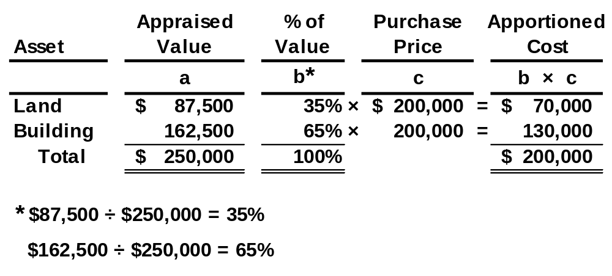
Lump-Sum Asset Purchase
ACCT 201 ACCT 201 ACCT 201
Notes:
Chapter 8: Reporting and Analyzing Long-Term Assets
Dr. Fred Barbee

Slide 18
Depreciation – The Concept

Slide 19
A Theoretical View of Depreciation
$2; $3; $4; SV
SV
$1; $2; $3; $4; SV
$3; $4; SV
$4; SV
Time
$1
$2
$3
$4
Consumed as Depreciation Expense
An application of the Matching Principle.
Notes:
Chapter 8: Reporting and Analyzing Long-Term Assets
Dr. Fred Barbee

Slide 20
Depreciation
Depreciation is a cost allocation process that systematically and rationally matches acquisition costs of plant assets with periods benefited by their use.
Balance Sheet
Income Statement
Acquisition
Cost
Cost
Expense
Allocation
(Unused)
(Used)
Notes:
Chapter 8: Reporting and Analyzing Long-Term Assets
Dr. Fred Barbee

Slide 21
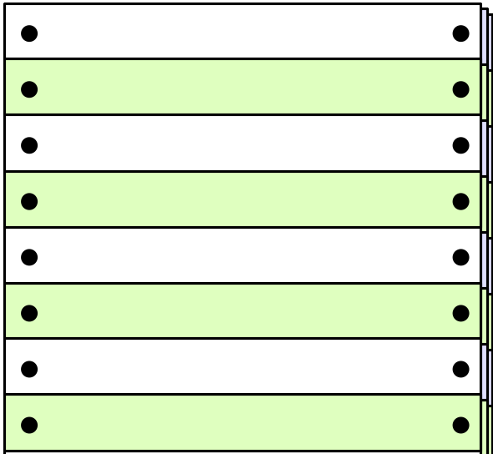
Depreciation
Income
Statement
Depreciation
Expense
Depreciation for
the current year
Balance
Sheet
Accumulated
Depreciation
Total depreciation to
date of balance sheet
Notes:
Chapter 8: Reporting and Analyzing Long-Term Assets
Dr. Fred Barbee

Slide 22


Factors in Computing Depreciation
The calculation of depreciation requires three amounts for each asset:
    Cost.
    Salvage Value.
    Useful Life.
Notes:
Chapter 8: Reporting and Analyzing Long-Term Assets
Dr. Fred Barbee

Slide 23

Depreciation Methods
Straight-line
Units-of-production
Declining balance
Notes:
Chapter 8: Reporting and Analyzing Long-Term Assets
Dr. Fred Barbee

Slide 24

Depreciation
If an asset is expected to benefit all periods equally,
  a straight-line method of depreciation would be appropriate.

Slide 25
Depreciation
If more benefits are expected early in the life of an asset . . .
  an accelerated method of depreciation would be appropriate.

Slide 26
Depreciation
If benefits are related to the output of an asset . . .
  the units-of-production method of depreciation would be appropriate.

Slide 27


Depreciation and the Tax Code
ACCT 201 ACCT 201 ACCT 201

Slide 28



Depreciation and the Tax Code
1981 thru 1986
< 1981
1987>

Slide 29
Depreciation and the Tax Code
1981 thru 1986
< 1981
1987>
Could use any of four methods:
Straight-Line
Declining Balance
Units-of-Output
Sum-of-the-Years’ Digits

Slide 30
Depreciation and the Tax Code
1981 thru 1986
< 1981
1987>
Accelerated Cost
Recovery System (ACRS)

Slide 31
Depreciation and the Tax Code
1981 thru 1986
< 1981
1987>
Modified
Accelerated Cost
Recovery System (MACRS)

Slide 32
Methods of Depreciation
Straight-Line Method

Slide 33
Straight-Line Method
Depreciation
Expense per Year
Cost - Salvage Value
Useful life in years
=
Appropriate if an asset is expected to benefit all periods equally.
ACCT 201 ACCT 201 ACCT 201
Notes:
Chapter 8: Reporting and Analyzing Long-Term Assets
Dr. Fred Barbee

Slide 34
Straight-Line Method
On December 31, 2001, equipment was purchased for $50,000 cash. The equipment has an estimated useful life of 5 years and an estimated residual value of $5,000.
Depreciation Expense Per Year | = | $50,000 - $5,000
 |  | 5 Years
 | = | $9,000
ACCT 201 ACCT 201 ACCT 201
Notes:
Chapter 8: Reporting and Analyzing Long-Term Assets
Dr. Fred Barbee

Slide 35
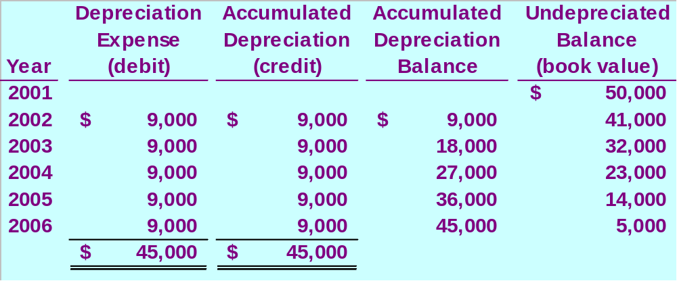
Straight-Line Method
Salvage Value
ACCT 201 ACCT 201 ACCT 201
Notes:
Chapter 8: Reporting and Analyzing Long-Term Assets
Dr. Fred Barbee

Slide 36
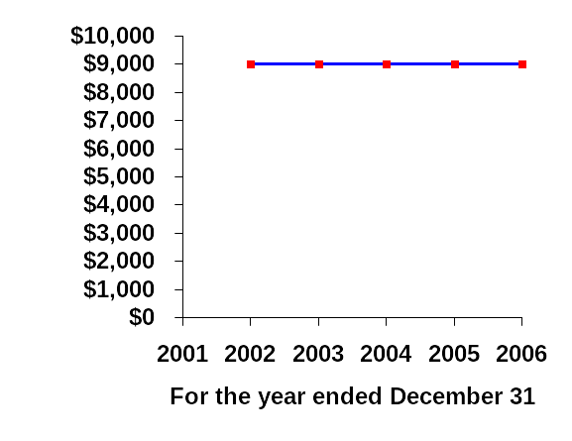
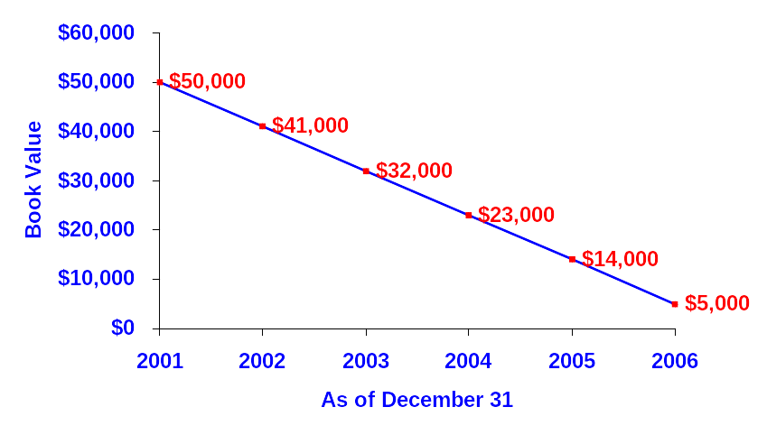
Depreciation Expense is reported on the Income Statement.
Depreciation Expense
Book Value is reported on the Balance Sheet.
Notes:
Chapter 8: Reporting and Analyzing Long-Term Assets
Dr. Fred Barbee

Slide 37
Units-of-Production Method
Exh.
8.9
Step 1:
Depreciation
Per Unit
Cost - Salvage Value
Total Units of Production
=
Step 2:
Number of Units Produced
in the Period
Depreciation
Expense
Depreciation
Per Unit
=
×
ACCT 201 ACCT 201 ACCT 201
Notes:
Chapter 8: Reporting and Analyzing Long-Term Assets
Dr. Fred Barbee

Slide 38
Units-of-Production Method
On December 31, 2001, equipment was purchased for $50,000 cash.
  The equipment is expected to produce 100,000 units during its useful life and has an estimated salvage value of $5,000.
  If 22,000 units were produced in 2002, what is the amount of depreciation expense?
Notes:
Chapter 8: Reporting and Analyzing Long-Term Assets
Dr. Fred Barbee

Slide 39
Units-of-Production Method
Step 1:
Depreciation
Per Unit
$50,000 - $5,000
100,000 units
=
= $.45 per unit
Step 2:
Depreciation
Expense
=
$.45 per unit × 22,000 units = $9,900
ACCT 201 ACCT 201 ACCT 201
Notes:
Chapter 8: Reporting and Analyzing Long-Term Assets
Dr. Fred Barbee

Slide 40
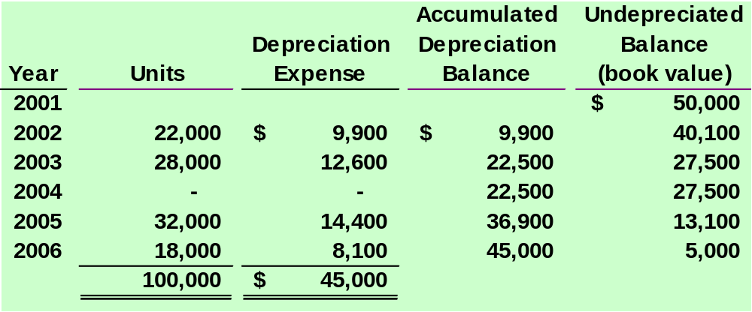
Units-of-Production Method
Salvage Value
No depreciation expense if the equipment is idle.
ACCT 201 ACCT 201 ACCT 201
Notes:
Chapter 8: Reporting and Analyzing Long-Term Assets
Dr. Fred Barbee

Slide 41
Declining Balance Method
Depreciation
Repair
Expense
Expense
Early Years
High
Low
Later Years
Low
High
Early years’ total expense approximates
later years’ total expense.
Notes:
Chapter 8: Reporting and Analyzing Long-Term Assets
Dr. Fred Barbee

Slide 42
Accelerated Depreciation
Repair Costs
Depreciation

Slide 43
Double-Declining-Balance Method
Exh.
8.11
Step 1:
Straight-line
depreciation rate
100 %
Useful life in periods
=
Step 2:
Double-declining-
balance rate
Straight-line
depreciation rate
= 2 ×
Step 3:
Depreciation
expense
Double-declining-
balance rate
Beginning period
book value
=
×
Ignores salvage value
Notes:
Chapter 8: Reporting and Analyzing Long-Term Assets
Dr. Fred Barbee

Slide 44
Double-Declining-Balance Method
On December 31, 2001, equipment was purchased for $50,000 cash.
The equipment has an estimated useful life of 5 years and an estimated residual value of $5,000.
Calculate the depreciation expense for 2002 and 2003
Notes:
Chapter 8: Reporting and Analyzing Long-Term Assets
Dr. Fred Barbee

Slide 45
Double-Declining-Balance Method
Step 1:
Straight-line
depreciation rate
100 %
5 years
=
= 20%
Step 2:
Double-declining-
balance rate
= 2 × 20% = 40%
Step 3:
Depreciation
expense
= 40% × $50,000 = $20,000 (2002)
Notes:
Chapter 8: Reporting and Analyzing Long-Term Assets
Dr. Fred Barbee

Slide 46
Double-Declining-Balance Method
2002 Depreciation:
40% × $50,000 = $20,000
2003 Depreciation:
40% × ($50,000 - $20,000) = $12,000
Notes:
Chapter 8: Reporting and Analyzing Long-Term Assets
Dr. Fred Barbee

Slide 47
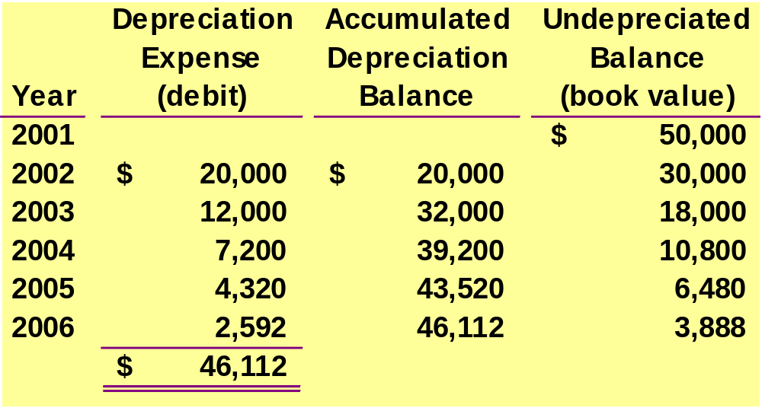
Double-Declining-Balance Method
Below salvage value
($50,000 – $43,520) × 40% = $2,592
Notes:
Chapter 8: Reporting and Analyzing Long-Term Assets
Dr. Fred Barbee

Slide 48
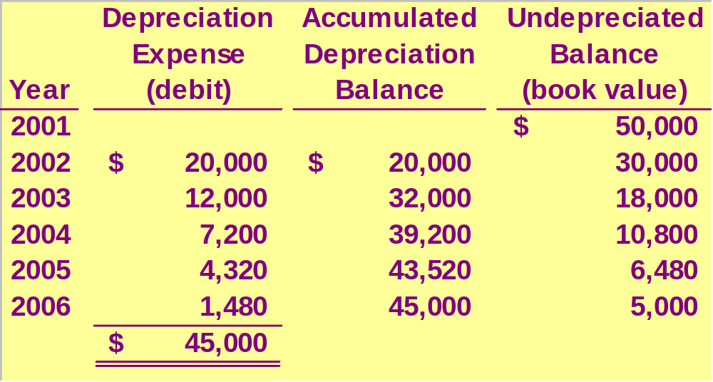
Double-Declining-Balance Method
We usually have to force depreciation expense in the
latter years to an amount that brings BV to salvage value.
Notes:
Chapter 8: Reporting and Analyzing Long-Term Assets
Dr. Fred Barbee

Slide 49
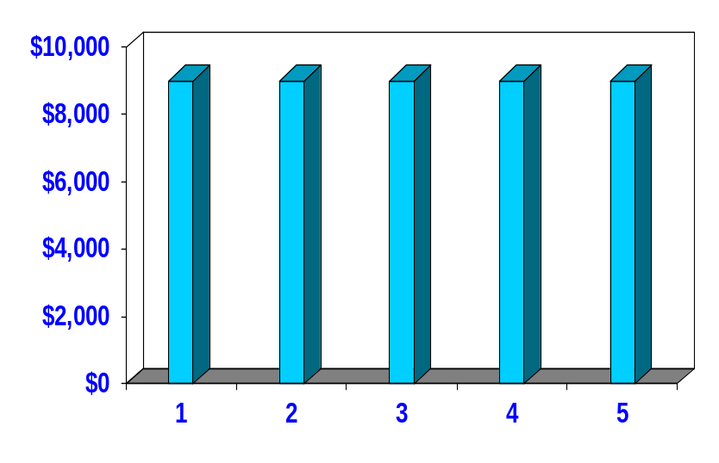
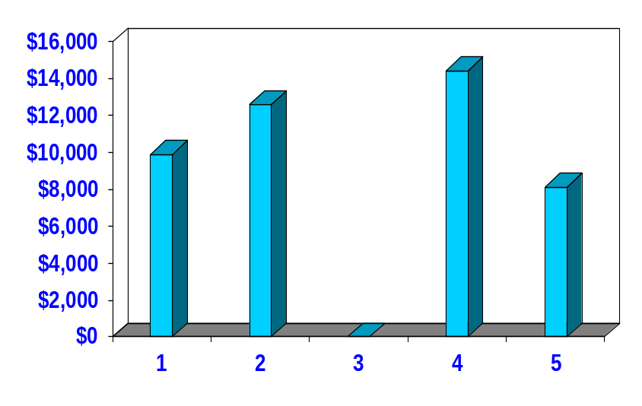
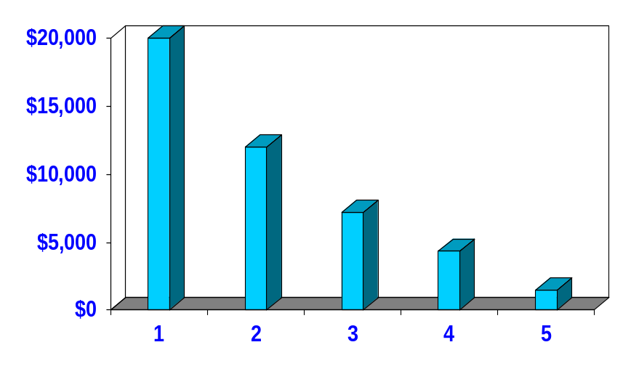
Comparing Depreciation Methods
Straight-Line
Units-of-Production
Annual
Depreciation
Annual
Depreciation
Life in Years
Life in Years
Double-Declining-Balance
Annual
Depreciation
Life in Years
Notes:
Chapter 8: Reporting and Analyzing Long-Term Assets
Dr. Fred Barbee

Slide 50
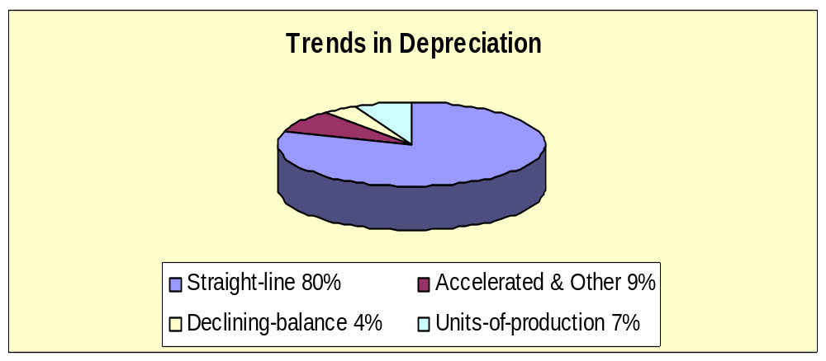
Comparing Depreciation Method
Notes:
Chapter 8: Reporting and Analyzing Long-Term Assets
Dr. Fred Barbee

Slide 51
Depreciation for Tax Reporting
Most corporations use the Modified Accelerated Cost Recovery System (MACRS) for tax purposes.
MACRS depreciation provides for rapid write-off of an asset’s cost in order to stimulate new investment.
Notes:
Chapter 8: Reporting and Analyzing Long-Term Assets
Dr. Fred Barbee

Slide 52

Partial Year Depreciation
When a plant asset is acquired
during the year, depreciation
is calculated for the fraction of
the year the asset is owned.
June
30
Notes:
Chapter 8: Reporting and Analyzing Long-Term Assets
Dr. Fred Barbee

Slide 53
Partial Year Depreciation
Calculate the straight-line depreciation on December 31, 2003, for equipment purchased on June 30, 2003.
The equipment cost $75,000, has a useful life of 10 years and an estimated salvage value of $5,000.
Notes:
Chapter 8: Reporting and Analyzing Long-Term Assets
Dr. Fred Barbee

Slide 54
Partial Year Depreciation
Depreciation = ($75,000 - $5,000) ÷ 10
= $7,000 for a full year
Depreciation = $7,000 × ⁶/₁₂ = $3,500
Notes:
Chapter 8: Reporting and Analyzing Long-Term Assets
Dr. Fred Barbee

Slide 55
Revising Depreciation Rates
Predicted
salvage value
Predicted
useful life
So depreciation
is an estimate.
Over the life of an asset, new information may come to light that indicates the
original estimates were inaccurate.
ACCT 201 ACCT 201 ACCT 201
Notes:
Chapter 8: Reporting and Analyzing Long-Term Assets
Dr. Fred Barbee

Slide 56
Revising Depreciation Rates
On January 1, 2000, equipment was purchased that cost $30,000, has a useful life of 10 years and no salvage value.
During 2003, the useful life was revised to 8 years total (5 years remaining).
Notes:
Chapter 8: Reporting and Analyzing Long-Term Assets
Dr. Fred Barbee

Slide 57
Revising Depreciation Rates
Calculate depreciation expense for the year ended December 31, 2003, using the straight-line method.
Book value at
date of change
–
Salvage value at
date of change
Remaining useful life at date of change
Notes:
Chapter 8: Reporting and Analyzing Long-Term Assets
Dr. Fred Barbee

Slide 58
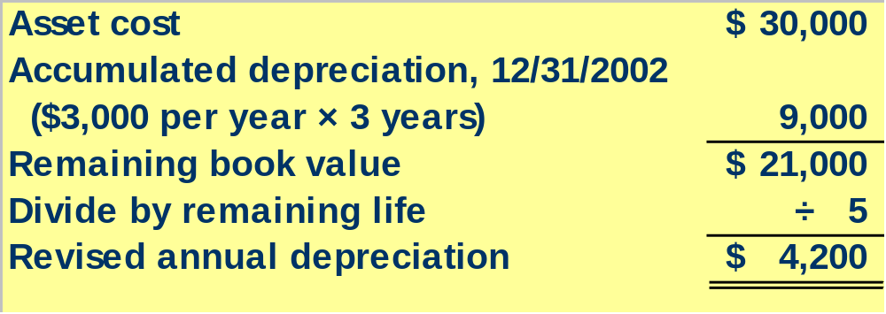
Revising Depreciation Rates
ACCT 201 ACCT 201 ACCT 201
Notes:
Chapter 8: Reporting and Analyzing Long-Term Assets
Dr. Fred Barbee

Slide 59
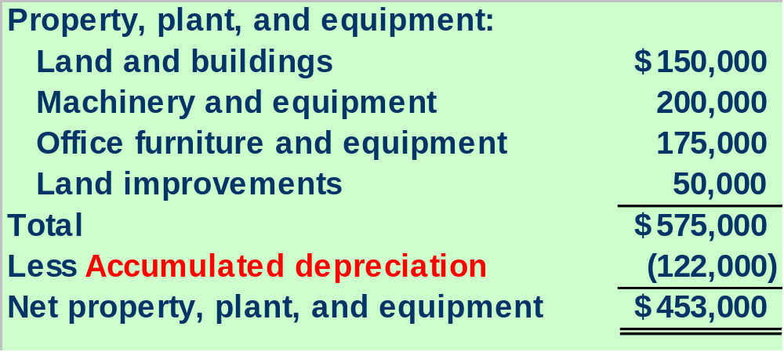
Reporting Depreciation
Net property, plant, and equipment is the undepreciated cost (book value) of the plant assets.
Book value ≠ Market value
Notes:
Chapter 8: Reporting and Analyzing Long-Term Assets
Dr. Fred Barbee

